Slide 1
Chapter 10
Externalities
Professor Galvez-Soriano lecture notes. Based on N. Gregory Mankiw, Principles of Microeconomics, 9th Edition.

Slide 2
Externalities
Government action can sometimes improve upon market outcomes
Why markets sometimes fail to allocate resources efficiently
How government policies can potentially improve the market’s allocation
What kinds of policies are likely to work best
Professor Galvez-Soriano lecture notes. Based on N. Gregory Mankiw, Principles of Microeconomics, 9th Edition.

Slide 3

Externalities
Externality
The uncompensated impact of one person’s actions on the well-being of a bystander
Market failure
Negative externality
Impact on the bystander is adverse
Positive externality
Impact on the bystander is beneficial
Professor Galvez-Soriano lecture notes. Based on N. Gregory Mankiw, Principles of Microeconomics, 9th Edition.
Notes:
Covid vaccination is a positive externality because even if you do not get the shot, Covid contagious will decreased in town and, hence, you will have a lower likelihood of getting infected.

Slide 4
Externalities
Negative externalities
Exhaust from automobiles
Barking dogs
Positive externalities
Restored historic buildings
Research into new technologies
Professor Galvez-Soriano lecture notes. Based on N. Gregory Mankiw, Principles of Microeconomics, 9th Edition.
Notes:
dioxide carbon emissions

Slide 5
Externalities and Market Inefficiency
Welfare economics: A recap
Demand curve: value to consumers
Prices they are willing to pay
Supply curve: cost to suppliers
Equilibrium quantity and price
Efficient
Maximizes the sum of producer and consumer surplus
Professor Galvez-Soriano lecture notes. Based on N. Gregory Mankiw, Principles of Microeconomics, 9th Edition.

Slide 6
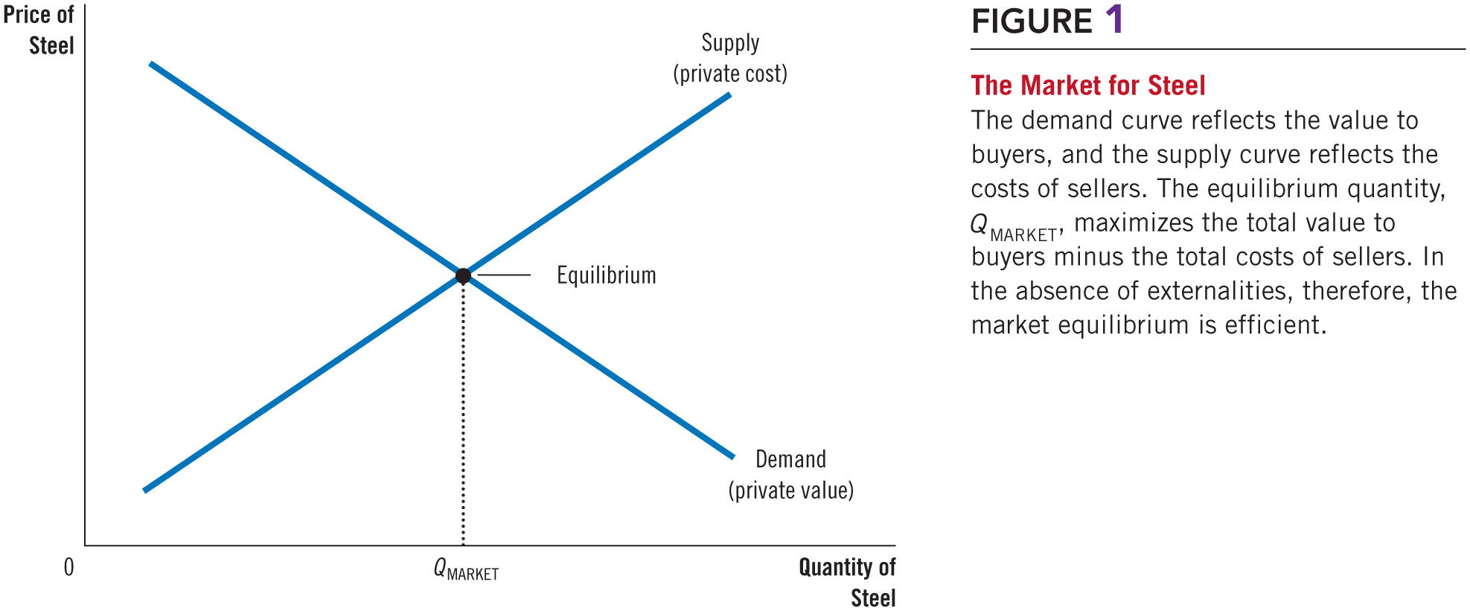

Figure 1 The Market for Steel
Professor Galvez-Soriano lecture notes. Based on N. Gregory Mankiw, Principles of Microeconomics, 9th Edition.

Slide 7

Externalities and Market Inefficiency
Negative externalities
Social cost
Private costs of the producers (supply)
Plus the costs to those bystanders affected adversely by the negative externality
Social cost curve is above the supply curve
Professor Galvez-Soriano lecture notes. Based on N. Gregory Mankiw, Principles of Microeconomics, 9th Edition.

Slide 8
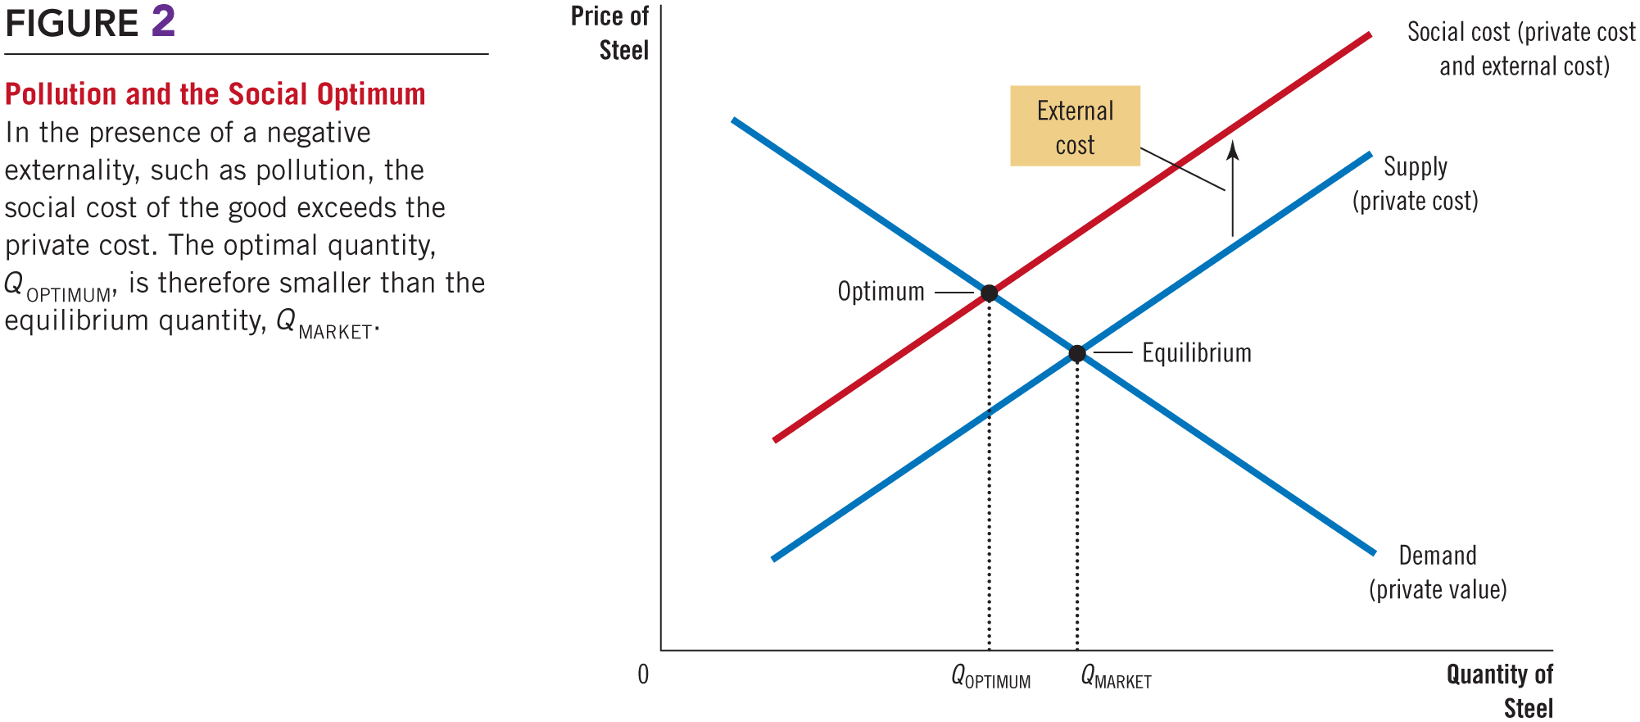

Figure 2 Pollution and the Social Optimum
Professor Galvez-Soriano lecture notes. Based on N. Gregory Mankiw, Principles of Microeconomics, 9th Edition.
Notes:
The external cost is the costs to those bystanders affected

Slide 9
Externalities and Market Inefficiency
Negative externalities
Optimum quantity produced
Maximize total welfare
Smaller than market equilibrium quantity
Government – correct market failure
Internalizing the externality
Altering incentives so that people take account of the external effects of their actions
Professor Galvez-Soriano lecture notes. Based on N. Gregory Mankiw, Principles of Microeconomics, 9th Edition.

Slide 10
Externalities and Market Inefficiency
Positive externalities
Education
Benefit of education is private
Externalities: better government, lower crime rates, higher productivity and wages
Social value is greater than private value
Social value curve
Above the demand curve
Professor Galvez-Soriano lecture notes. Based on N. Gregory Mankiw, Principles of Microeconomics, 9th Edition.

Slide 11
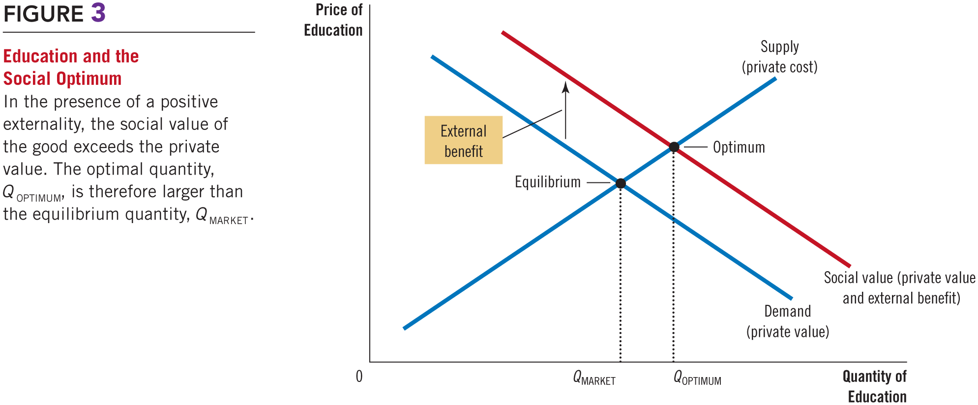

Figure 3 Education and the Social Optimum
Professor Galvez-Soriano lecture notes. Based on N. Gregory Mankiw, Principles of Microeconomics, 9th Edition.

Slide 12
Externalities and Market Inefficiency
Positive externalities
Socially optimal quantity is greater than market equilibrium quantity
Government – correct market failure
Internalize the externality
Subsidy
Professor Galvez-Soriano lecture notes. Based on N. Gregory Mankiw, Principles of Microeconomics, 9th Edition.

Slide 13

Externalities and Market Inefficiency
Negative externalities
Markets produce a larger quantity than is socially desirable
Government: tax
Positive externalities
Markets produce a smaller quantity than is socially desirable
Government: subsidy
Professor Galvez-Soriano lecture notes. Based on N. Gregory Mankiw, Principles of Microeconomics, 9th Edition.

Slide 14
Public Policies toward Externalities
Regulation
Regulate behavior directly: making certain behaviors either required or forbidden
Corrective taxes and subsidies
Corrective taxes (Pigovian taxes)
Professor Galvez-Soriano lecture notes. Based on N. Gregory Mankiw, Principles of Microeconomics, 9th Edition.

Slide 15
Public Policies toward Externalities
Tradable pollution permits
Voluntary transfer of the right to pollute from one firm to another
Professor Galvez-Soriano lecture notes. Based on N. Gregory Mankiw, Principles of Microeconomics, 9th Edition.

Slide 16
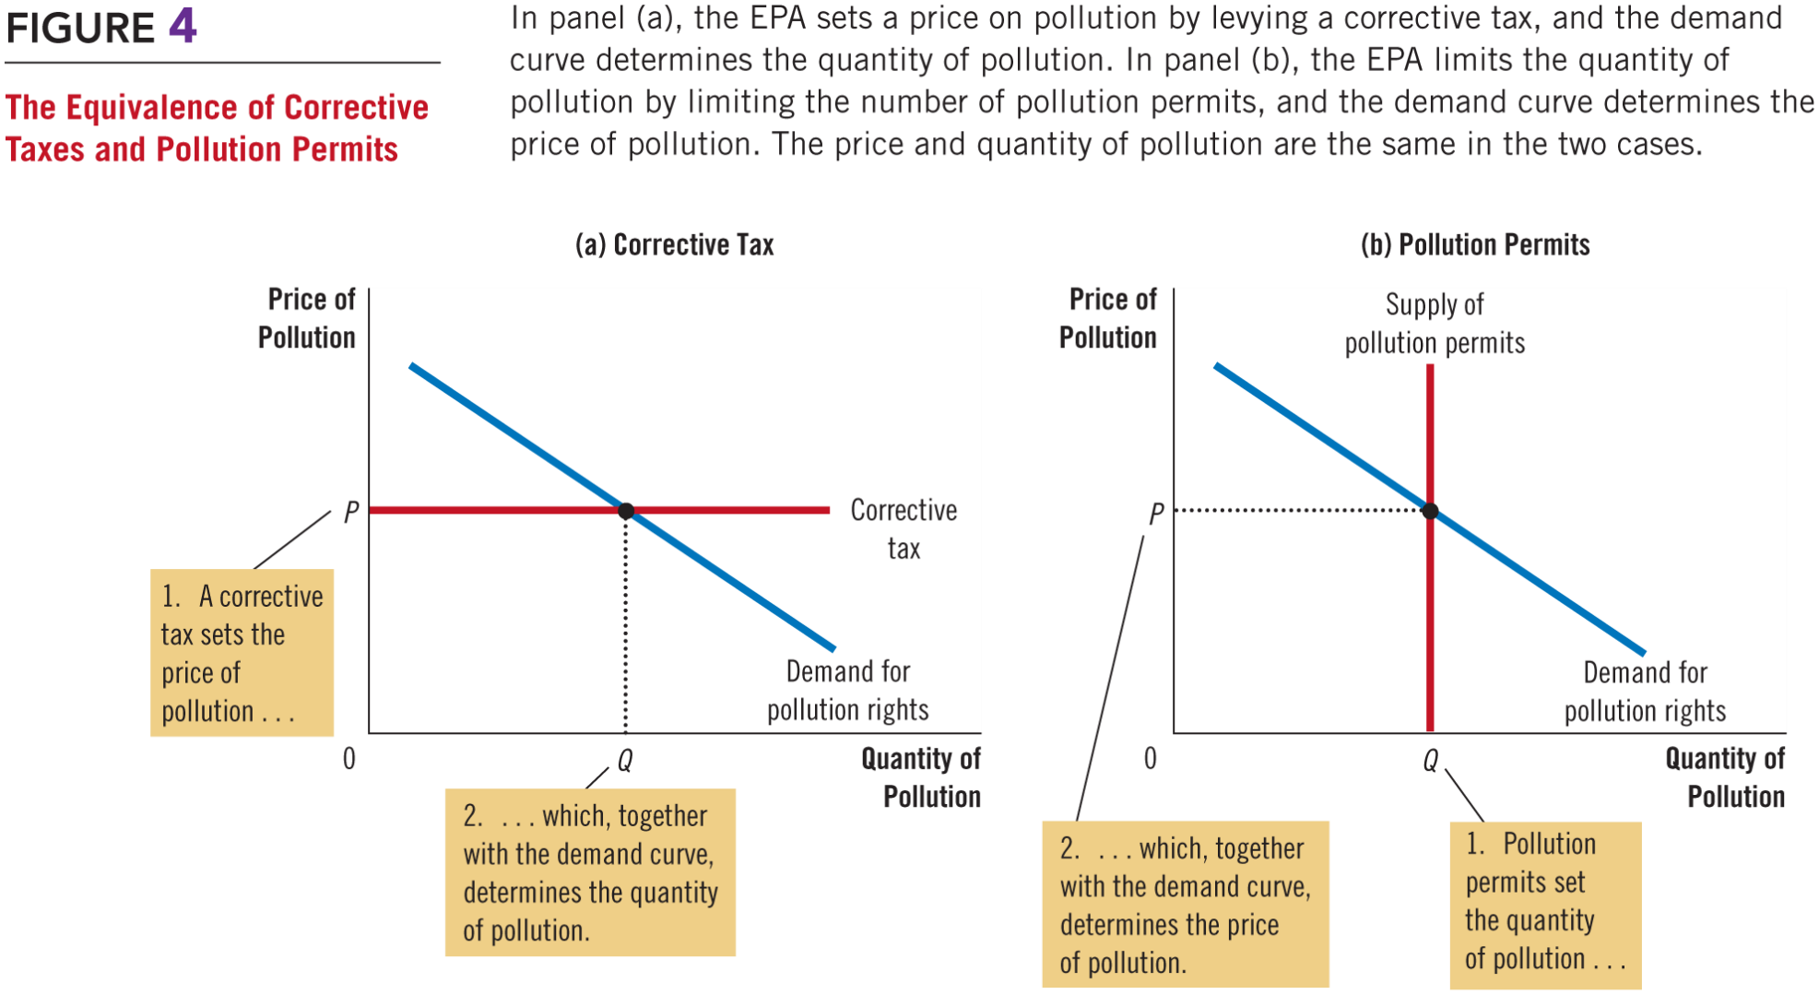
Figure 4 The Equivalence of Corrective Taxes and Pollution Permits
Professor Galvez-Soriano lecture notes. Based on N. Gregory Mankiw, Principles of Microeconomics, 9th Edition.
Notes:
Environmental Protection Agency.
Dictates maximum level of pollution
Requires that firms adopt a particular technology to reduce emissions

Slide 17
Private Solutions to Externalities
1. Emily has the legal right to keep a barking dog.
Emily gets a $500 benefit from the dog
Horace bears an $800 cost from the barking
Efficient outcome:
Horace can offer Emily $600 to get rid of the dog
Emily will gladly accept
Professor Galvez-Soriano lecture notes. Based on N. Gregory Mankiw, Principles of Microeconomics, 9th Edition.
Notes:
The Coase theorem

Slide 18
Private Solutions to Externalities
2. Emily has the legal right to keep a barking dog.
Emily gets a $1,000 benefit from the dog
Horace bears an $800 cost from the barking
Efficient outcome:
Emily turns down any offer below $1,000
Horace will not offer any amount above $800
Emily keeps the dog
Professor Galvez-Soriano lecture notes. Based on N. Gregory Mankiw, Principles of Microeconomics, 9th Edition.

Slide 19
Private Solutions to Externalities
3. Horace can legally compel Emily to get rid of the dog.
Emily can offer to pay Horace to allow her to keep the dog
Professor Galvez-Soriano lecture notes. Based on N. Gregory Mankiw, Principles of Microeconomics, 9th Edition.
Notes:
If the benefit of the dog to Emily exceeds the cost of the barking to Horace
Then Emily and Horace will strike a bargain in which Emily keeps the dog

